Slide 1

Customer Behaviour Recognition in Retail Store from Surveillance Camera
Presented
By
AWANEESH KISORE [1DS13CS026]
HARSH REWARI [1DS13CS042]
KEWAL KISHAN G [1DS13CS047]
RISHAB RAINA [1DS13CS081]
Under the Guidance of:
Prof. Rashmi S R
Assistant Professor,
Dept of Computer Science & Engineering
Department of Computer Science & Engineering, DSCE

Slide 2
OVERVIEW
The presentation would deal with the following:
Introduction
Objective
Literature survey
Methodology
Architecture Diagram
Flowchart
Experiments
Results
Conclusion
References
Department of Computer Science & Engineering, DSCE

Slide 3
INTRODUCTION
Studies of customer behaviour in retail stores usually deal with identification of customers and their buying behaviour patterns
An accurate and efficient tracking capability at the heart of such a system is essential for building higher level vision-based intelligence.
Surveillance has an objective to monitor a given environment and report the information about the observed activity that is of significant interest.
Using Convolutional and Recurrent Neural Network ,we analyse and classify video sequences into four classes namely walking, touching, picking and taking.
Department of Computer Science & Engineering, DSCE

Slide 4
l
OBJECTIVE
The main purpose of our project is to detect the customer behaviour (in front of the shelf) taken from surveillance camera in retail stores using Convolutional and Recurrent Neural Network to analyse and classify them into four classes namely walking, touching, picking and taking.
Department of Computer Science & Engineering, DSCE

Slide 5
l
LITERATURE SURVEY
Automatic motion tracking of a human in a surveillance video, Mohammed A. AlGhamdi, Murtaza A. Khan, Sultan H. AlMotiri
In this paper we describe a method of automatic motion tracking of a person in a sequence of video frames. The method is suitable for tracking a person walking or running in a surveillance video captured from a single still camera. The method initially removes noise from the captured images then segments the images using frame difference and binary conversion techniques and finally tracks the person using a bounding box based on occurrence of high intensity values horizontally and vertically. Simulation results show that the method can be used for real-time tracking of humans in videos with frame-rate of 25/30 fps. In the context of a Smart-city, the purposed system serves as a part of Internet of Things (IoT) and transmits the capture video to control-center for processing.
Department of Computer Science & Engineering, DSCE

Slide 6
l
LITERATURE SURVEY
J. Liu, Y. Gu, and S. Kamijo, “Customer Behavior Recognition in Retail Store from Surveillance Camera,” in IEEE International Symposium on Multimedia (ISM), 2015
The analysis of customer behavior from surveillance camera is one of the most important open topics for marketing. The authors develop a system to recognize different customer behaviors on the front of shelf: no interest, viewing, turning to shelf, touching, picking and returning to shelf and picking and putting into basket. In the proposed system, head orientation, body orientation, and arm action, the multiple cues are integrated for the customer behavior recognition. The proposed system discretizes the head and body orientation of customer into 8 directions to estimate whether the customer is looking or turning to the merchandise shelf. Semi-Supervised Learning method is applied to optimize the training dataset and to generate an accurate classifier. As for the arm action recognition, a novel combined hand feature (CHF), which includes hand trajectory, tracking status and the relative position between hand and shopping basket, is proposed to describe different arm actions.
Department of Computer Science & Engineering, DSCE

Slide 7
l
LITERATURE SURVEY
J. Liu, Y. Gu, and S. Kamijo, “Joint Customer Pose and Orientation Estimation using Deep Neural Network from Surveillance Camera,” in IEEE International Symposium on Multimedia (ISM), 2016
Retailers are most concerned with the customers near the merchandise shelf. In those areas, the customer pose and orientation are highly dependent on each other. Therefore, the authors propose a joint customer pose and orientation estimation system from surveillance video by using deep Neural Network. This system composes the dependency between pose and orientation. In addition, considering the customer pose and orientation changes gradually over time, the authors apply a prediction structure to improve the system performance. In this structure, the estimated pose and orientation of one frame are both used to enhance the estimation of next frame. We also propose a two-step learning algorithm to train this network. The experimental results also prove the effectiveness of our proposed system.
Department of Computer Science & Engineering, DSCE

Slide 8
l
LITERATURE SURVEY
Motion Detection Techniques Using Optical Flow, A. A. Shafie, Fadhlan Hafiz, and M. H. Ali
Motion detection is very important in image processing. One way of detecting motion is using optical flow. Optical flow cannot be computed locally, since only one independent measurement is available from the image sequence at a point, while the flow velocity has two components. A second constraint is needed. The method used for finding the optical flow in this project is assuming that the apparent velocity of the brightness pattern varies smoothly almost everywhere in the image. This technique is later used in developing software for motion detection which has the to carry out four types of motion detection. The motion detection software presented in this project also can highlight motion region, count motion level as well as counting object numbers. Many objects such as vehicles and human from video streams can be recognized by applying optical flow technique.
Department of Computer Science & Engineering, DSCE

Slide 9
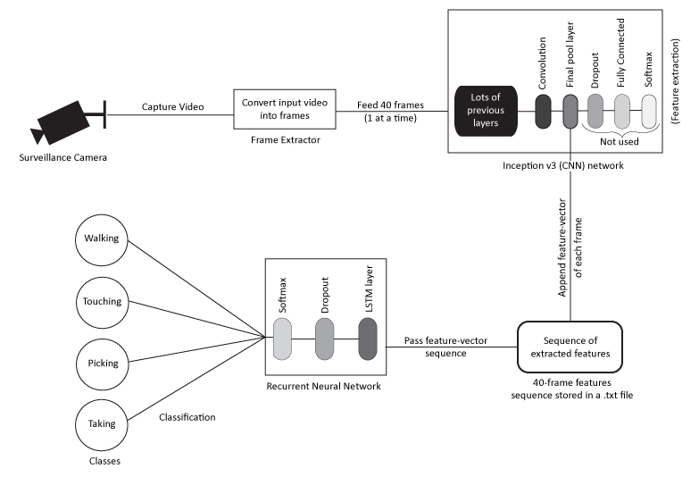
ARCHITECTURE DIAGRAM
Department of Computer Science & Engineering, DSCE

Slide 10
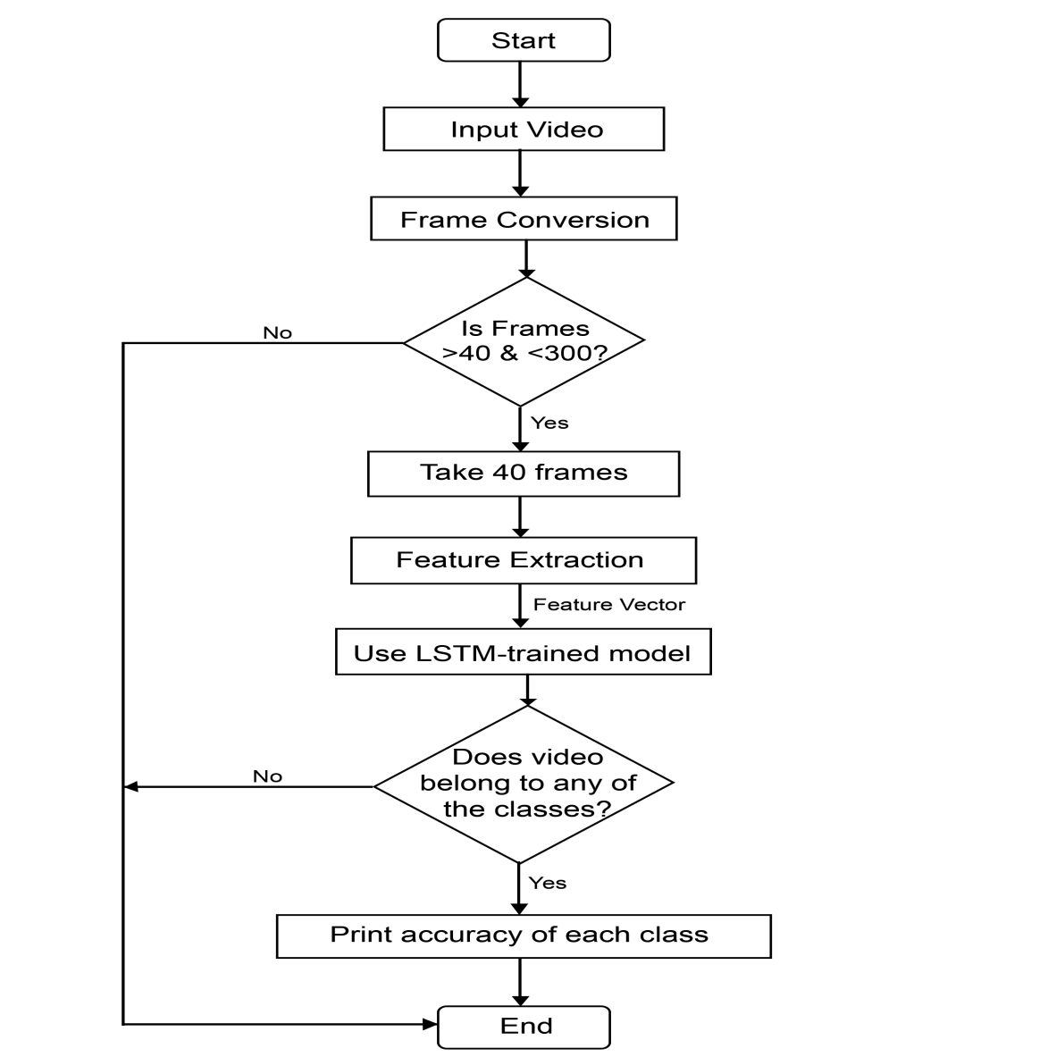

FLOWCHART
Department of Computer Science & Engineering, DSCE

Slide 11
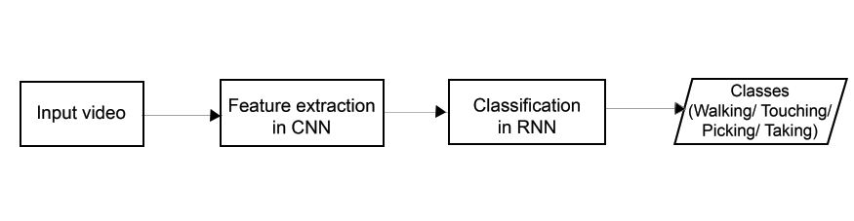
METHODOLOGY
First, we need to capture body movement of the customer in front of the shelf using surveillance camera.
After capturing the video we need to convert them into frames which are passed to Convolutional Neural Network.
CNN extracts the features of every frame and put them in a sequence.
This feature sequence is then fed into Recurrent Neural Network that classifies each sequence into four classes: Walking, Touching, Picking and Taking.
Department of Computer Science & Engineering, DSCE

Slide 12
METHOLOGY(CONTINUED)
Feature extraction using CNN: There is an input video from surveillance camera that we use to feed into CNN. First, the frames are extracted and then feature vector of each frame is created.
2. Classification of video using RNN: Once the features are extracted, they are converted into sequence of feature vector. This sequence is given as input to RNN.
RNN classifies the video into one of the defined classes.
Department of Computer Science & Engineering, DSCE

Slide 13
EXPERIMENTS
Our customer behaviour recognition system was first tested for efficiency using only CNN model. Since CNN cannot take sequence of images (i.e. a video), its accuracy overall was very less. It was not able to predict the motion in the video correctly.
We then implemented our system by using CNN along with RNN (LSTM network).
RNN are known for taking sequence of images as input and predicting the output from that.
When tested this model gave much better results (maximum of 96%) than only CNN model.
It was trained and tested with a lot more data for much better prediction. Test cases can be found out in figure ahead:
Department of Computer Science & Engineering, DSCE

Slide 14
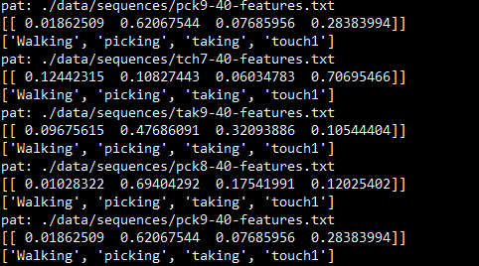
Department of Computer Science & Engineering, DSCE

Slide 15
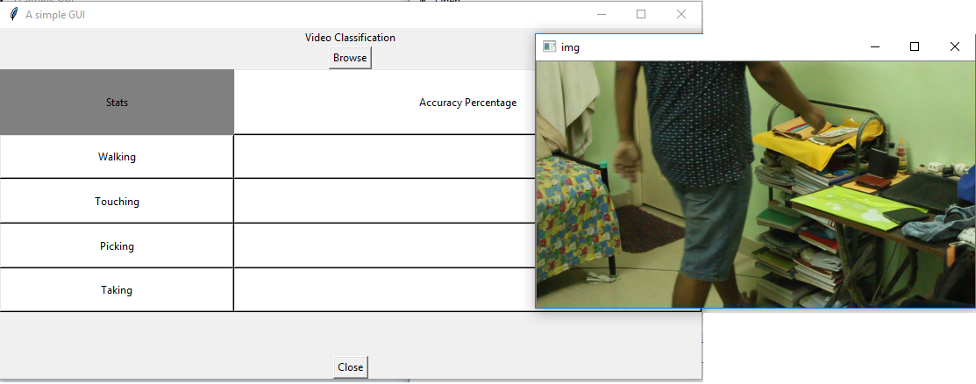
RESULTS
The results of the experiments are shown as table. In table, each row shows the result of each experiment.
Each column shows the recognition rate of different resolution. The recognition rate means the ratio of the number of correctly recognized images to the total image number of dataset
.
Department of Computer Science & Engineering, DSCE

Slide 16
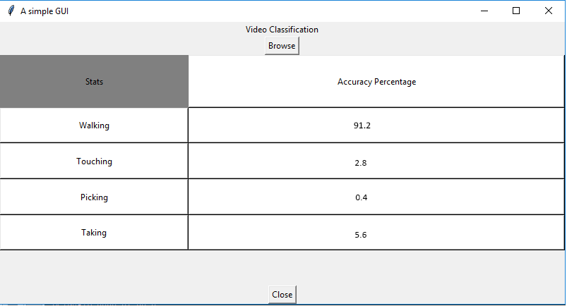
RESULTS(CONTINUED)
.
Department of Computer Science & Engineering, DSCE

Slide 17
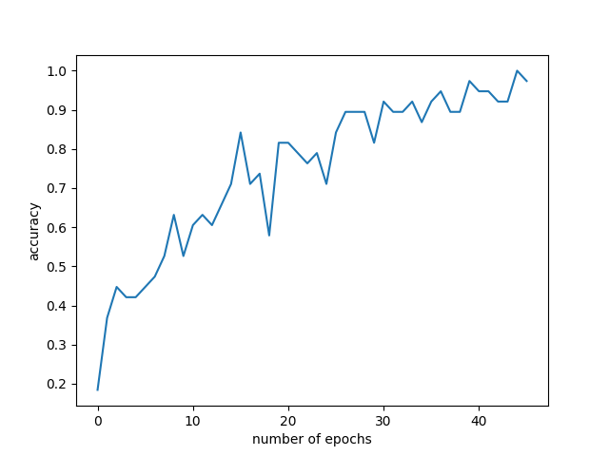
RESULTS(CONTINUED)
Department of Computer Science & Engineering, DSCE

Slide 18
CONCLUSION
Our system successfully takes a surveillance video as input and predicts the customer behaviour and classify it into four classes: Walking, Touching, Picking and Taking.
It can be used in retail sector without any further modifications. Classification is done automatically without the need of human involvement. For our current project there was very few data for training. It takes advantage of Convolution & Recurrent Neural Network to train & test data.
Accuracy
It gives accuracy of more than 60 percent on an average & for one of the classes it gave maximum accuracy 96 percent. However, in the future the accuracy and the efficiency of our network can be significantly improved by increasing the amount of data used for training hence giving much better results.
We will add more classes to the model so that it can predict more complex motion like picking the product and putting it into basket, head movements, etc.
Department of Computer Science & Engineering, DSCE

Slide 19
REFERENCES
[1] Haritaoglu, I., & Flickner, M. (2001). “Detection and tracking of shopping groups in stores”. In Computer Vision and Pattern Recognition, 2001. CVPR 2001. Proceedings of the 2001 IEEE Computer Society Conference on (Vol. 1, pp. I-431). IEEE.
[2] A.W. Senior, L. Brown, A. Hampapur, C.-F. Shu, Y. Zhai, R.S. Feris,Y.-L. Tian, S. Borger, C. Carlson, “Video analytics for retail”, AVSS, 2007, 2013 10th IEEE International Conference on Advanced Video,2007, pp. 423-428.
[3] Popa, M., Rothkrantz, L., Yang, Z., Wiggers, P., Braspenning, R., &
Shan, C. (2010, October). “Analysis of shopping behaviour based on
surveillance system”. In Systems Man and Cybernetics (SMC), 2010
IEEE International Conference on (pp. 2512-2519). IEEE.
[4] Lee, Kang-Dae, et al. “Context and profile based cascade classifier for efficient people detection and safety care system.” Multimedia Tools
and Applications63.1 (2013): 27-44.
Department of Computer Science & Engineering, DSCE

Slide 20
REFERENCES (CONTINUED)
[5] Abe, S., Morimoto, M., & Fujii, K. (2010, September). “Estimating face direction from wide view surveillance camera”. In World Automation Congress (WAC), 2010 (pp. 1-6). IEEE.
[6] Chen, C., Heili, A., & Odobez, J. M. (2011, August). “Combined estimation of location and body pose in surveillance video”. In Advanced Video and Signal-Based Surveillance (AVSS), 2011 8th IEEE International Conference on (pp. 5-10). IEEE.
[7] Liu, J., & Shah, M. (2008, June). “Learning human actions via information maximization”. In Computer Vision and Pattern Recognition, 2008. CVPR 2008. IEEE Conference on (pp. 1-8). IEEE.
[8] Niebles, J. C., & Fei-Fei, L. (2007, June). “A hierarchical model of shape and appearance for human action classification”. In Computer Vision and Pattern Recognition, 2007. CVPR'07. IEEE Conference on (pp. 1-8). IEEE.
Department of Computer Science & Engineering, DSCE

Slide 21
QUESTIONNAIRE
Department of Computer Science & Engineering, DSCE

Slide 22
THANK YOU
Department of Computer Science & Engineering, DSCE

